Slide 1


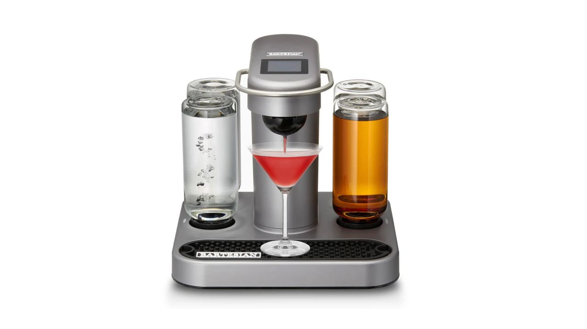

Group number 43
MIXMATICPRO
MOCKTAIL MACHINE

Slide 2
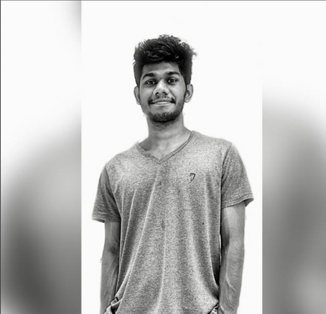
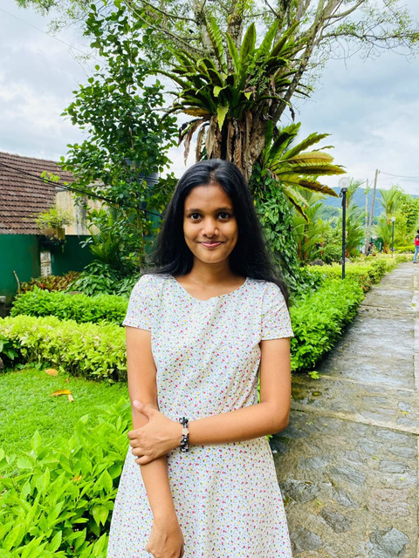
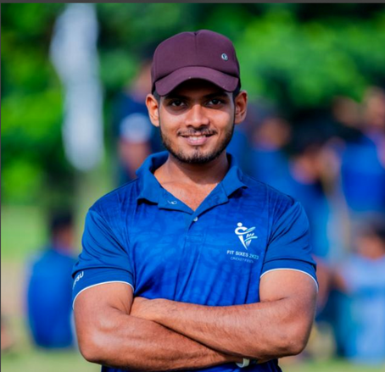
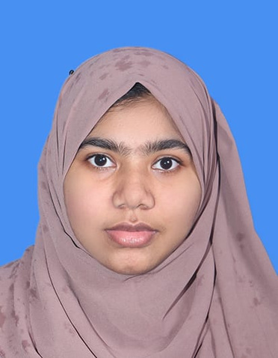


TEAM MEMBERS
224061N
224090C
224150L
224235D
224191L
1

Slide 3
Overview
Introduction
Problem In Brief
Aim
Objectives
Proposed solution
Individual Contribution
2

Slide 4
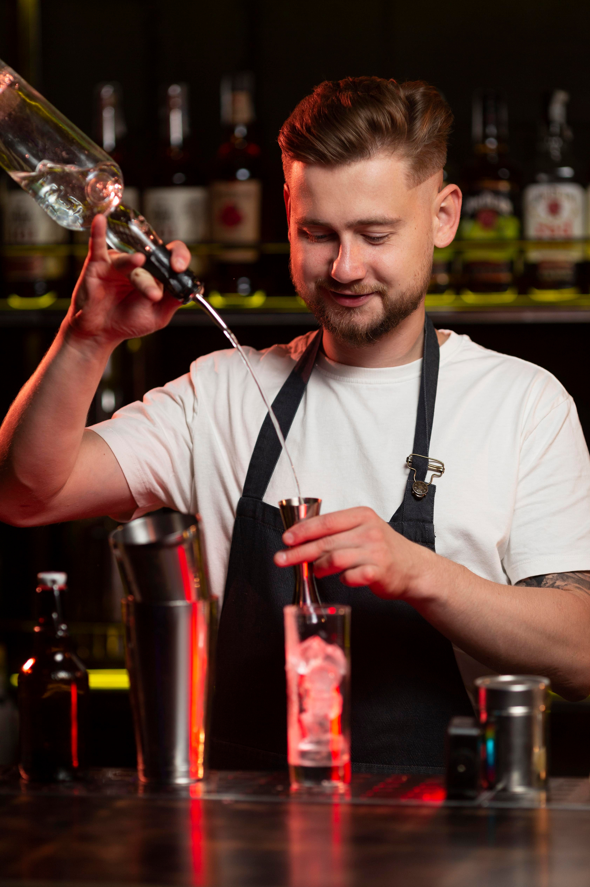
Problem In Brief
Traditional bars and juice establishments face
following challenges when making beverages
Inability to maintain taste and quality in a constant level
Inconsistent serving speed
Wastage of time of customers as it needs time for preparation
3

Slide 5
Objectives of the project
Enable price and recipe adjustments via web app without microcontroller reprogramming.
Monitor cup placement under dispensing system to reduce wastage of beverages.
Notify owner for ingredient refills to prevent customer dissatisfaction.
Offer user flexibility with diverse mocktail recipe options.
Seamless user experience with the customer through touch display.
Minimize machine footprint for space efficiency and portability.
4

Slide 6
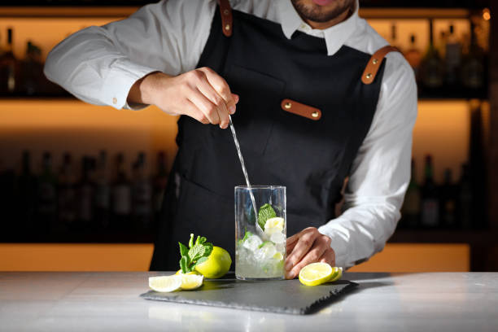
Aims of the Project
Implement an accurate and quantitative method to develop an automated mocktail machine, that makes mocktails which are consistent in taste and quality with less time. Also providing maximum flexibility to the customer through smooth user experience throughout the mocktail making process.
5

Slide 7
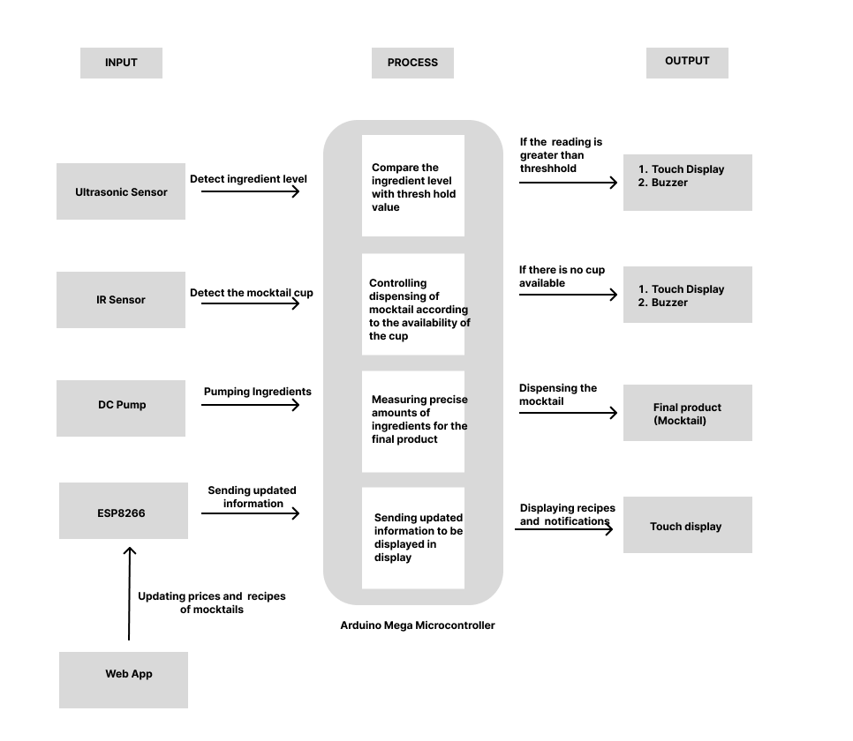
Proposed Solution
6

Slide 8


Individual Contribution
7

Slide 9
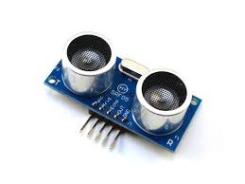
224090C-Jayasuriya M.D.I
Responsibilities
Setting up the four ultrasonic sensors (HC-SR04) inside the bottles lid and implement the code to check the liquids level are not below than the desired level.
Buzzer Implementation
8

Slide 10
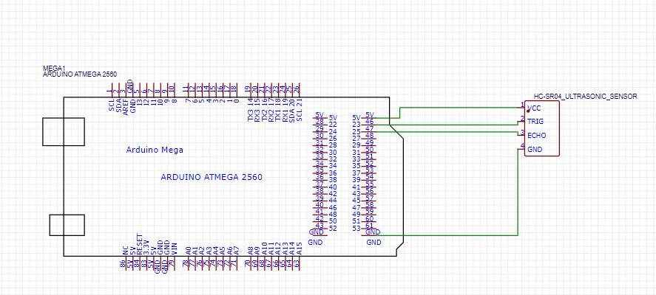
224090C-Jayasuriya M.D.I
Setting up the ultrasonic sensor
9

Slide 11
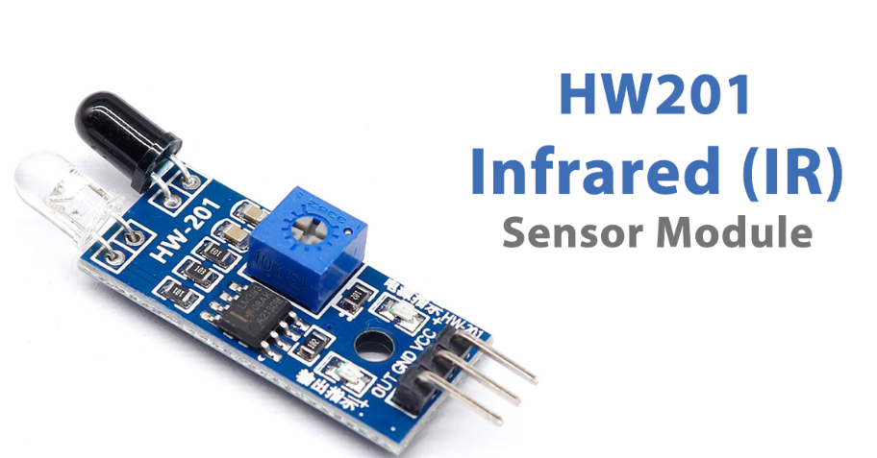
224235D - Hafza T.R.F
Responsibilities
Setting up the IR sensor to detect whether the cup is available
Cleaning process implementation
10

Slide 12
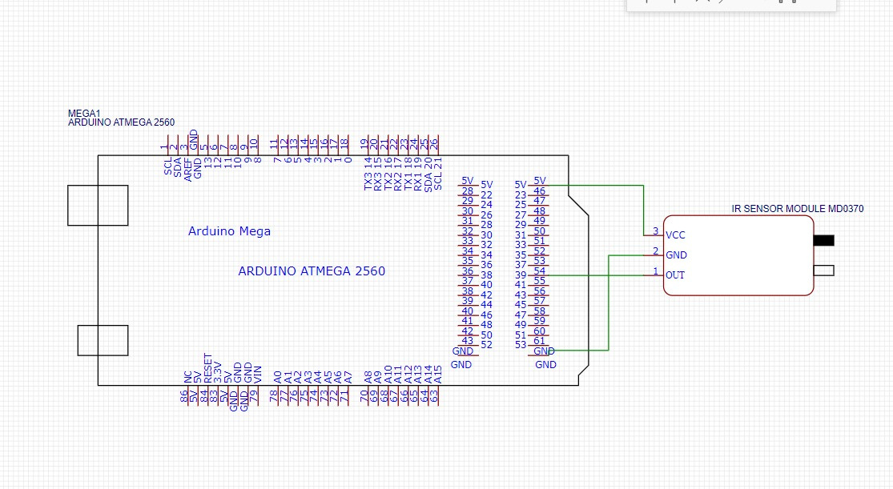
224235D - Hafza T.R.F
Setting up the IR sensor
11

Slide 13
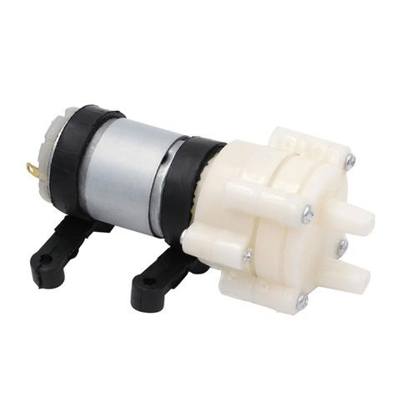
224150L - Perera W.T.S
Responsibilities
Setting up the DC pumps using relays
Implementing the capsule mechanism
Configuring Touch Display
Enclosure Design
12

Slide 14
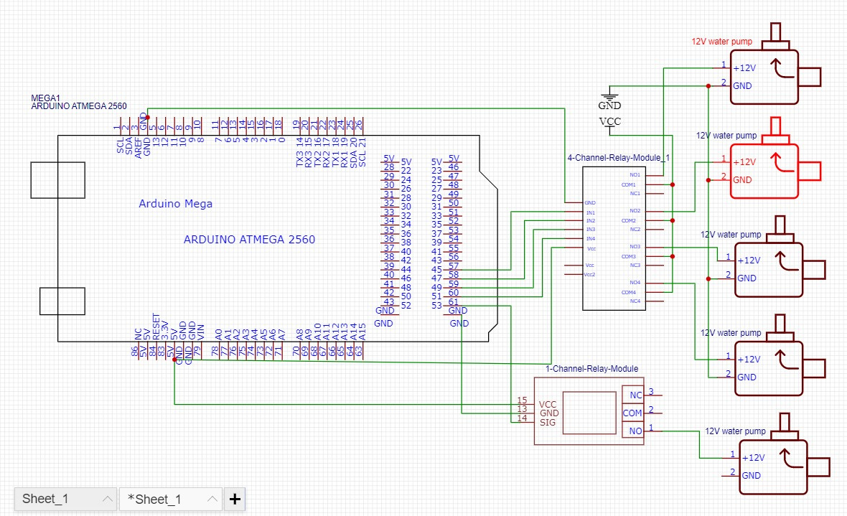
224150L - Perera W.T.S
Setting up the DC pumps using relays
13

Slide 15
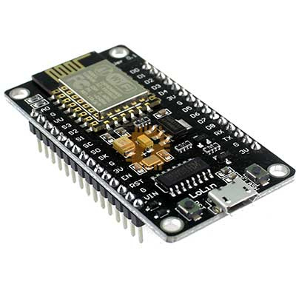
224061N - Gunathilake K.R.H.H
Responsibilities
Design and development of web app
Fetching Data from the web app to ESP8266
Transmitting data from ESP8266 to Arduino Mega through Seriel Communication
Configuring Touch Display
14

Slide 16
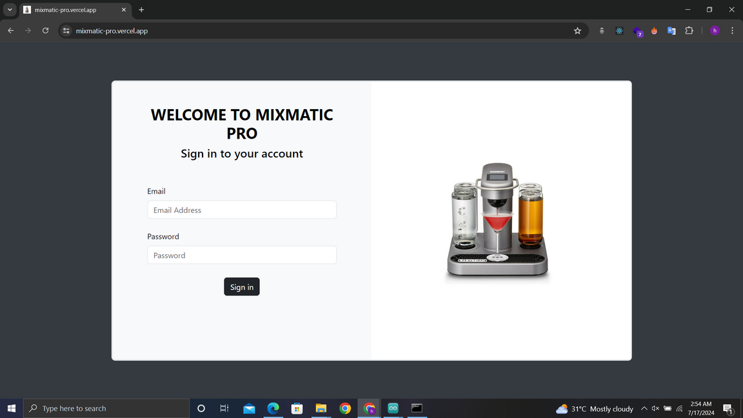
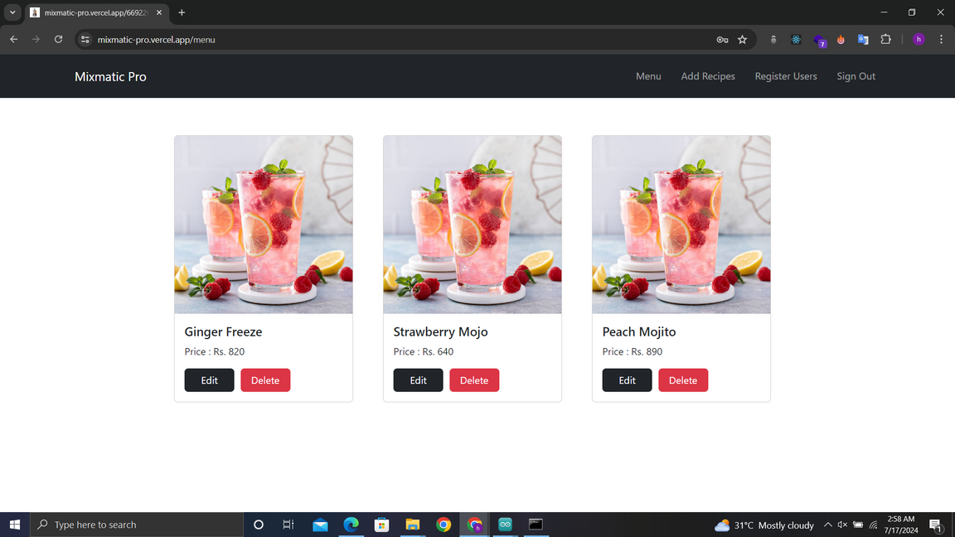
224061N - Gunathilake K.R.H.H
Design and Development of the web app
Repository link - https://github.com/HashiruG/mixmatic-web
15

Slide 17
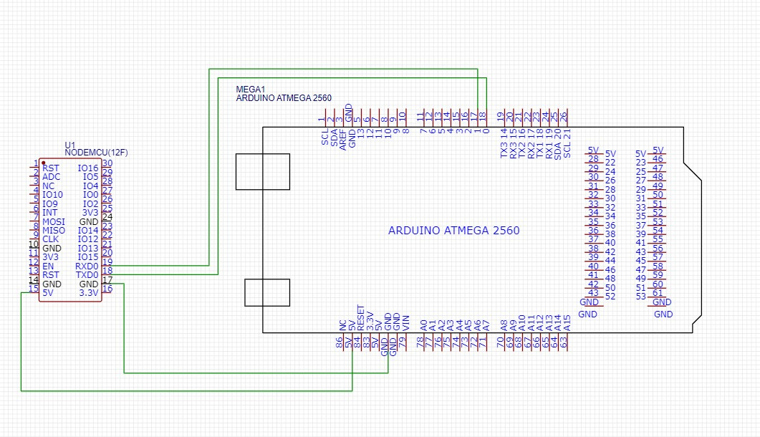
224061N - Gunathilake K.R.H.H
Establishing Seriel Communication between ESP8266 and Arduino Mega
15

Slide 18
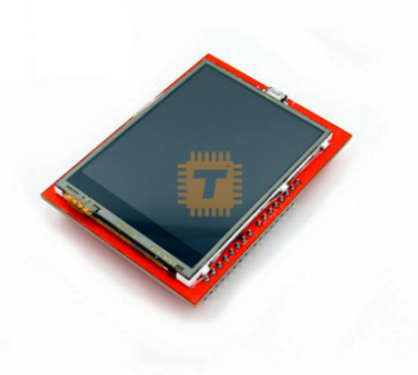
224191L-Thambiliyagoda T.G.C.J.
Responsibilities
PCB designing
LCD Display
Implementing the capsule mechanism
16

Slide 19
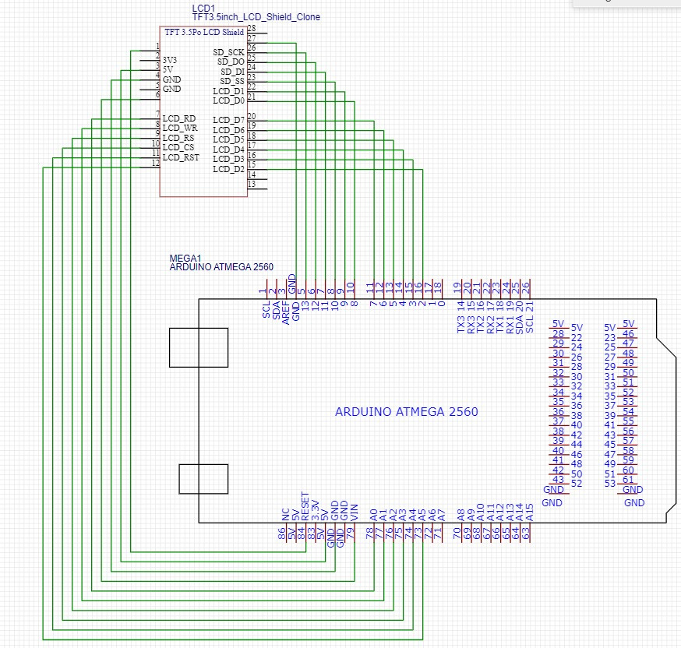
224191L-Thambiliyagoda T.G.C.J.
Interfacing touch display
17

Slide 20
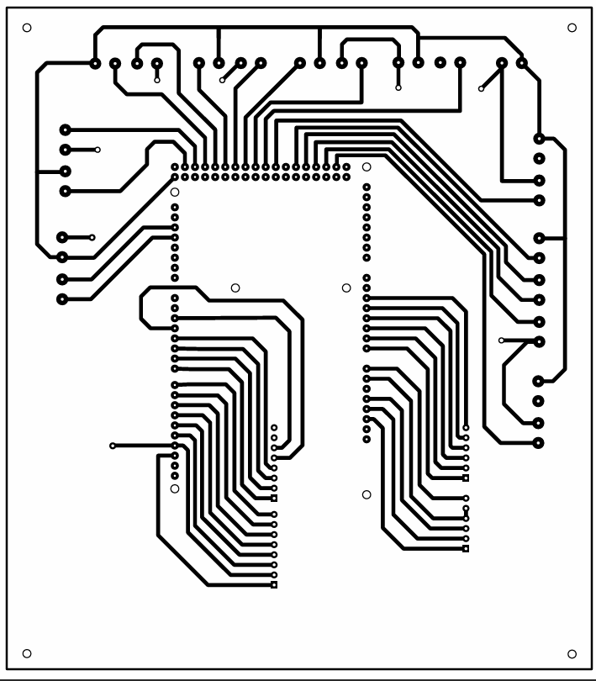
224191L-Thambiliyagoda T.G.C.J.
PCB design
17

Slide 21
THANK YOU
8

Slide 22
Q & A
8

